Slide 1
Data Analysis: Sales Prospects from Home Mortgage Data
The data present is that about the geographic data of where the borrower comes from, the borrower’s own data such as their annual income & age and finally the mortgage data such as the appraised value of the home, mortgage interest rate and amount borrowed.
The data is sorted into categories such as:
Geographic data that houses Wide Area Location Code, % Minority in Local Area & Median Family Income in Local Area
Borrower Data that houses Borrower Annual Income, Borrower Income Ratio, First Time Buyer whether yes or no represented by 1 or 2 respectively & Borrower Debt to Income Ratio
Mortgage Data that houses Appraised Value of Home, Amount Borrowed, LTV Ratio, Length of Mortgage in Months & Mortgage Interest Rate

Slide 2
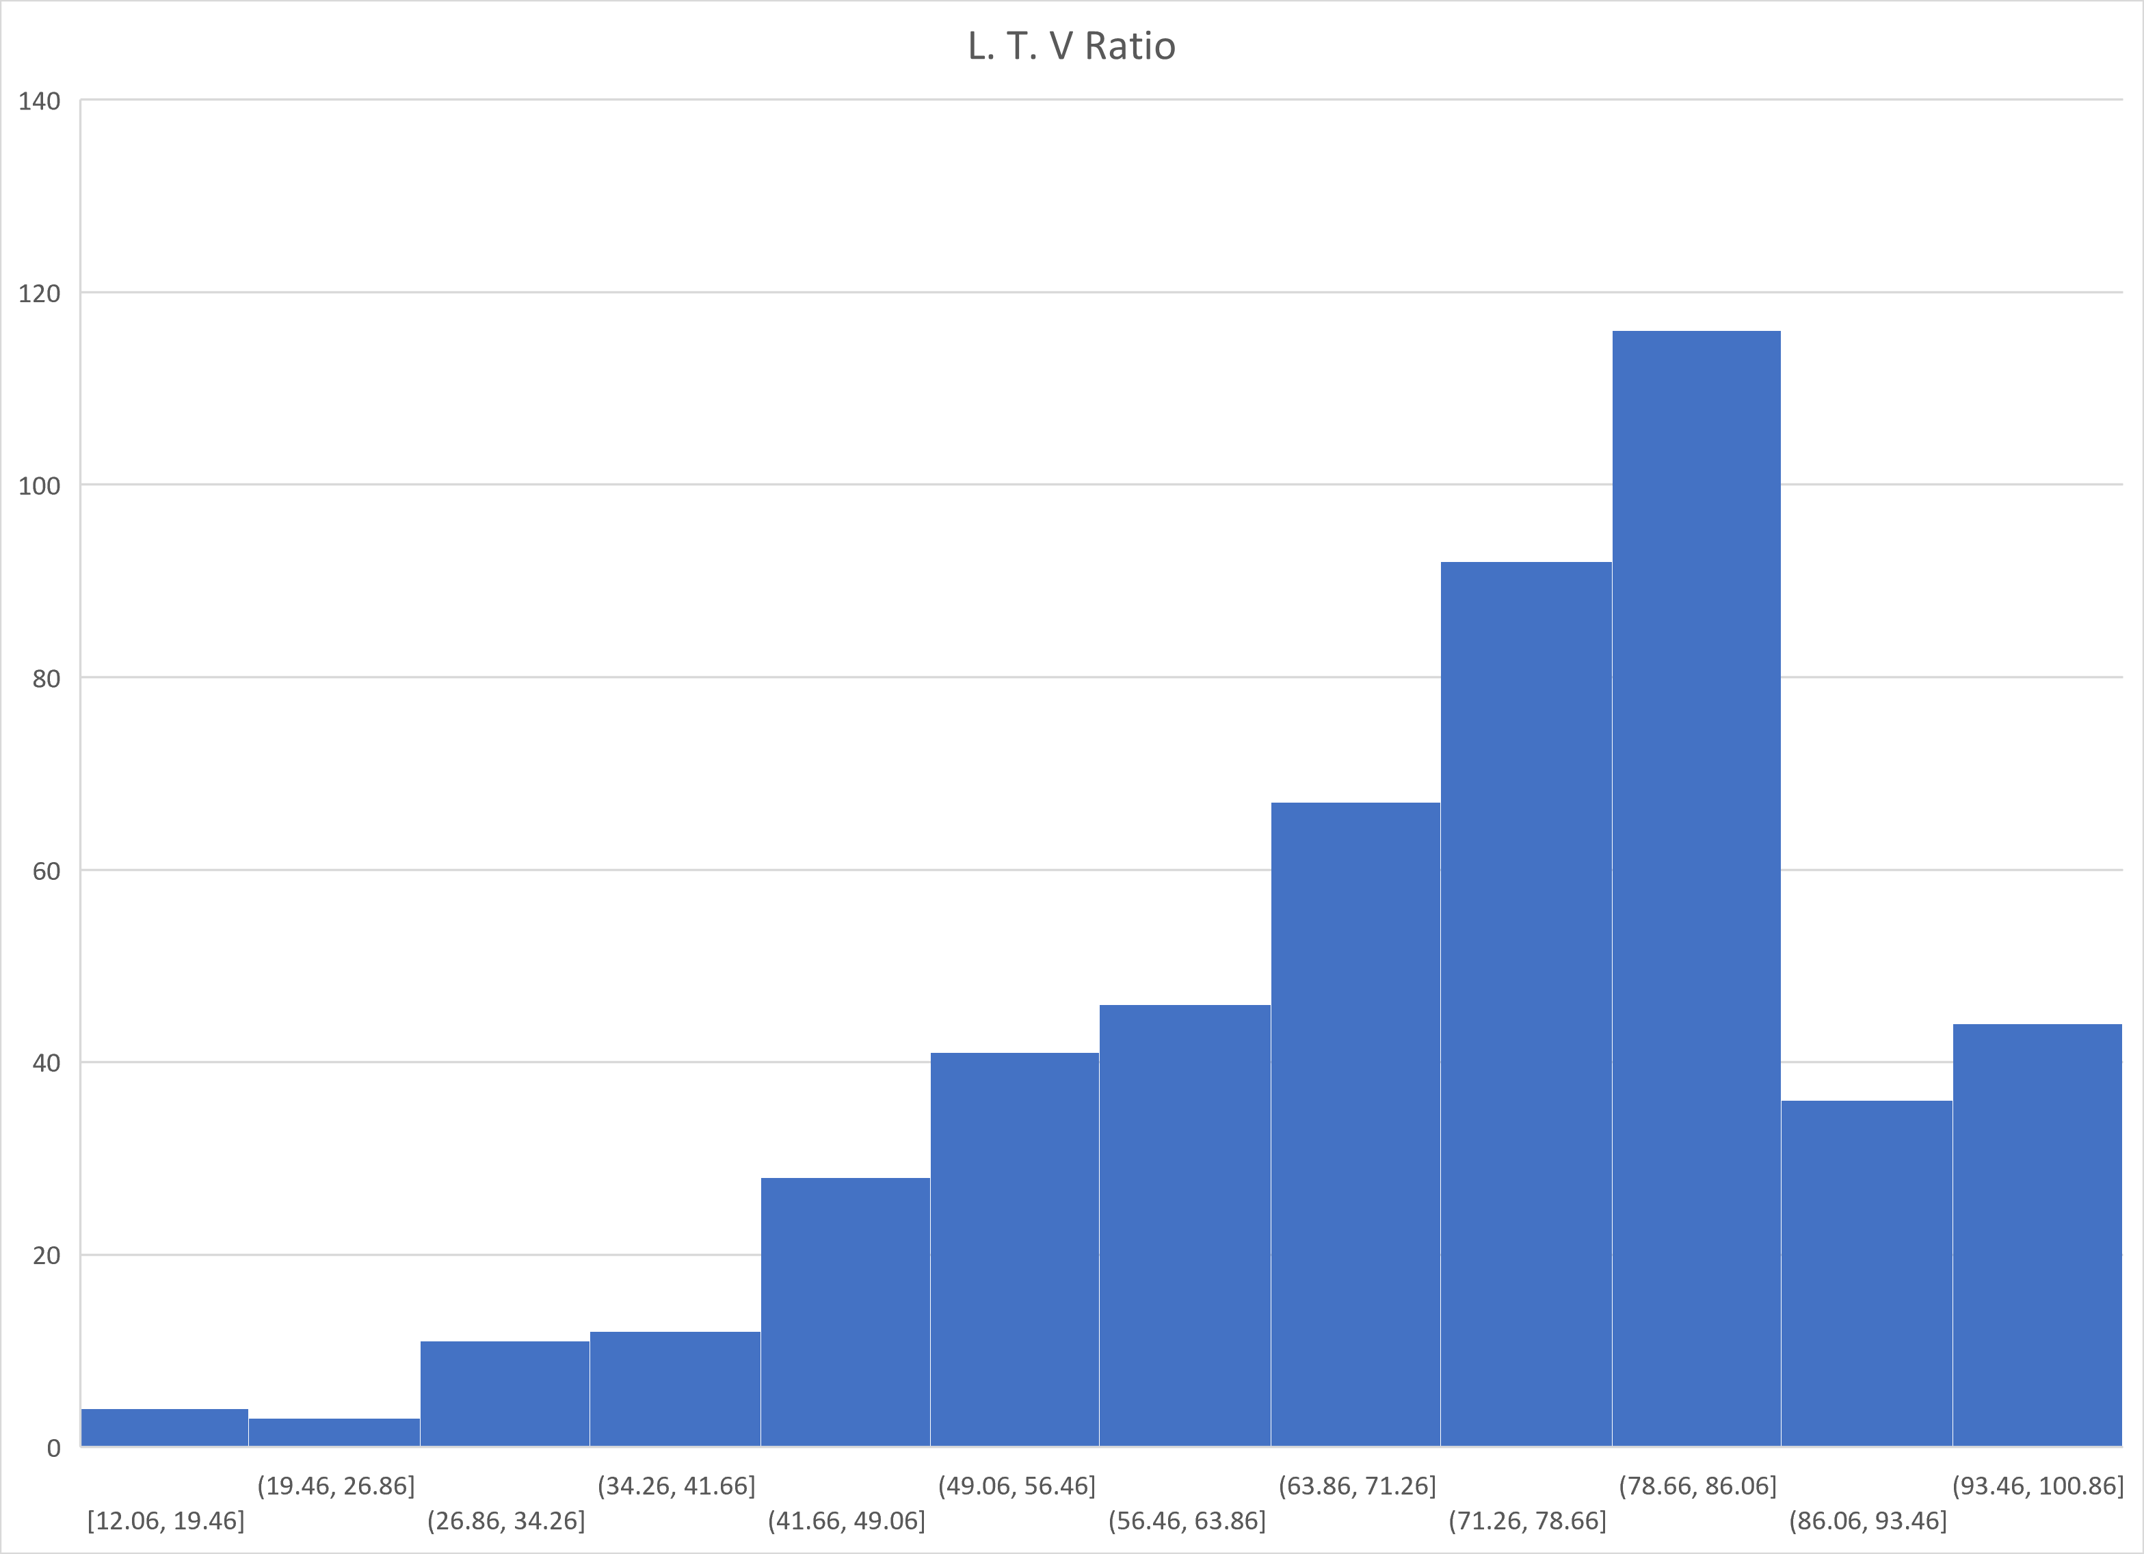
Approximately 60% of the borrowers have a Loan To Value ratio of 80% or less
The chart below shows Loan To Value ratio

Slide 3
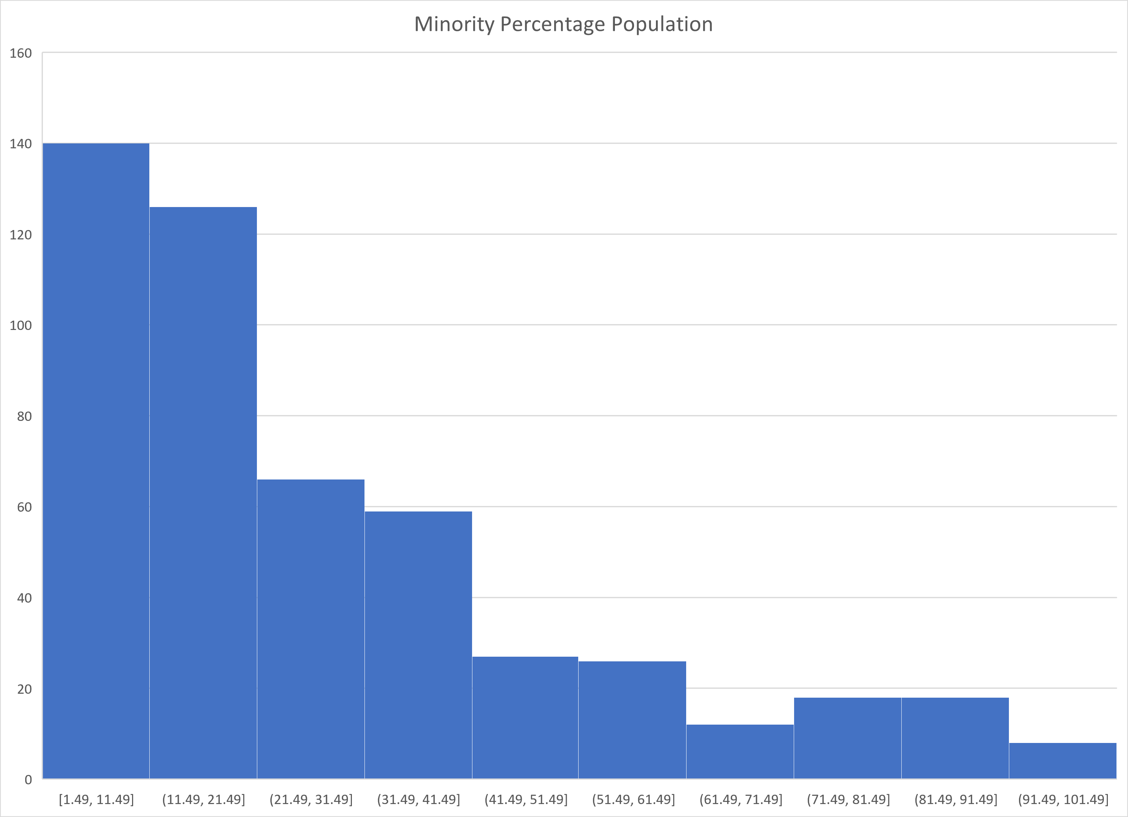
We can see that number of minority population is significantly low in many places and this needs to improve

Slide 4
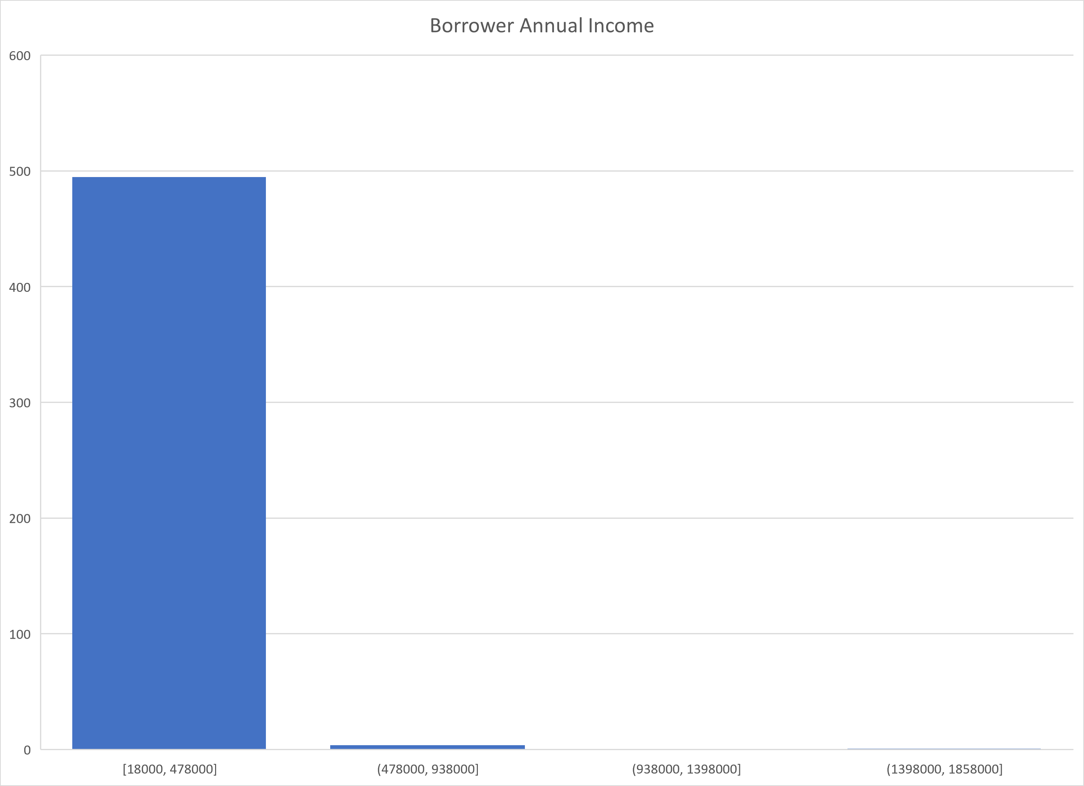
From this chart we can see that the average borrower makes well below $500K

Slide 5
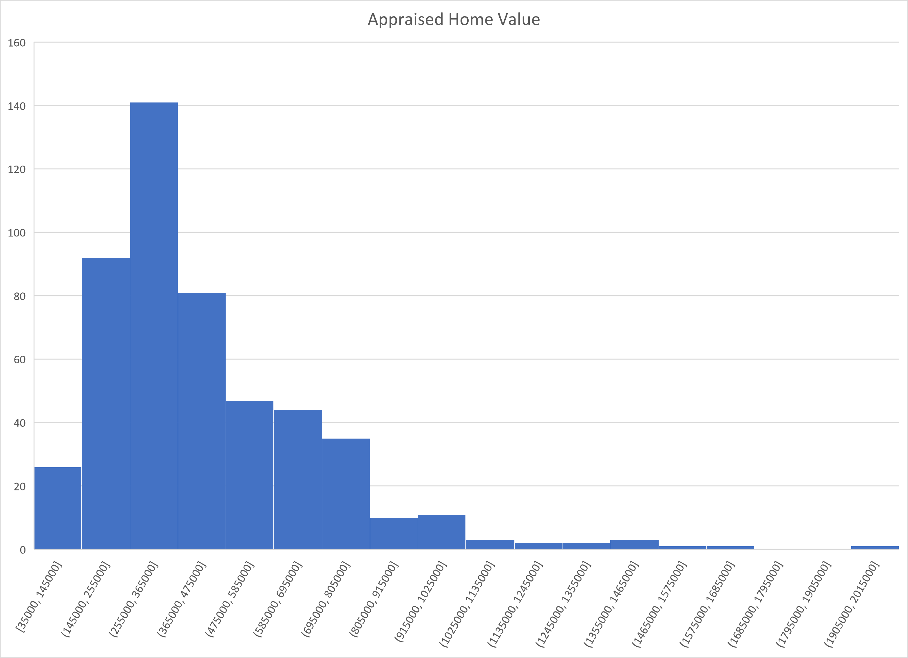
We can see that the average appraised home value is approximately $434K

Slide 6
Observations and Key Insights
Approximately 60% of the borrowers have a Loan To Value ratio of 80% or less
We can see that number of minority population is significantly low in many places and this needs to improve
From this chart we can see that the average borrower makes well below $500K
We can see that the average appraised home value is approximately $434K

